Slide 1
Project 1: Stock Price Prediction
National Taiwan Norm University Department of Computer Science and Information Engineering
110-2 Neuron Network
Chia-Hao, Chiang

Slide 2
Outline
Introduction
Architecture
Experiment & Result
Future work

Slide 3
Introduction

Slide 4
Introduction
Intuitively, RNN & LSTM but why?
Characteristics of stock price
Random walk? → Unrealistic, since its distribution tends to be uniform.
Benoit B. Mandelbrot: Fractal finance → markets are like the roiling seas; there is a long-term dependence in markets.
── ”The (Mis)Behavior of Market, A Fractal View of Risk, Ruin, and
Reward” 2004

Slide 5
Architecture (LSTM)

Slide 6
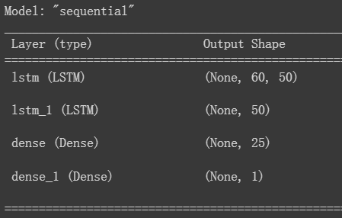
architecture (LSTM)
Input : every 60-day historic close price.
Number of hidden layer = 3
MinMaxScaler
Optimizer: Adam
Activation: tanh, since 2nd derivative can sustain for a long range before going to zero.
Training/validation set = 80/20%

Slide 7
Experiment & Result

Slide 8
experiment & Result (1)
Experiment: basically, compare different batch size and epoch with {1, 50, 100} and {10, 50, 100}, with counterpart = 10.
Metrics: RMSE
Results: it shows that
1) When fixing the batch size, as Epoch grows, the performance is not guaranteed to be better, and it could be worse and cost much of time training.
2) When fixing epochs, batch size has highly correlation with the performance.

Slide 9
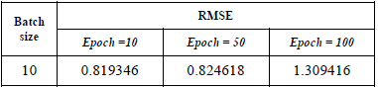
experiment & Result (2)
Batch size = 10, Epoch = {10, 50, 100}

Slide 10
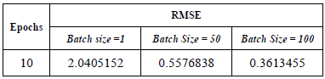
experiment & Result (3)
Epoch = 10, Batch size = {1, 50, 100}

Slide 11
Future Work

Slide 12
Future Work
Multi-variable input, including volume, open price, and highest/lowest price of the day.
Try different number of node, hidden layers, or maybe models.
Make comparisons to traditional (statistical) models.

Slide 13
Thanks for listening!

